Slide 1

Department of Agriculture & Farmer Welfare (DA&FW) PM KIsan SAmman Nidhi (PM-KISAN) Department of Agriculture &Farmer Welfare Government of India
19 April 2022

Slide 2
About the Scheme – PM-KISAN
Central sector scheme launched on 24th February 2019 to supplement financial needs of land holding farmers.
Direct benefit of Rs 6000 per year in three four-monthly instalments of Rs 2,000 each, per farmer family.
The scheme is applicable to all landholding farmers.
All installments due since December 2019 are paid only to Aadhaar seeded records, except Assam and Meghalya..
Till now, more than Rs 1.8 lakh crores have been transferred to more than 11.3 crore farmer families.
Special provisions are made for Northeastern States, Jharkhand etc. by High Level Committee as per Cabinet Note.

Slide 3
Exclusions Criteria in PM-KISAN
All Institutional Land holders.
Farmer Families/MP/MLA
Benefits are given to Farmer family
Professionals
Land Holders
Income Tax
Doctors
Engineers
Lawyers
Chartered Accountants, and Architects etc. registered with Professional bodies
Persons who paid Income Tax in last assessment year
All Persons who paid Income Tax in last assessment year
Former and present holders of constitutional posts.
Former and present Ministers/ State Ministers.
Former/present Members of Lok Sabha/ Rajya Sabha/ State Legislative Assemblies/ State Legislative Councils,
Pensioners
All superannuated/retired pensioners whose monthly pension is Rs.10,000/-or more
(Excluding Multi Tasking Staff / Class IV/Group D employees) of above category

Slide 4
Stakeholders of PM-KISAN
Department of Agriculture & Farmers Welfare
Public, Private, local Banks
Banks/
NPCI
DA & FW
Unique Identification Authority of India
States/UTs
States
UIDAI
PM-KISAN
Public Financial Management System
Common Service Centers
PFMS
CSCs

Slide 5
Responsibility of States/UTs in PM-KISAN
States/ UTs
Preparation, verification & Uploading of beneficiaries on portal.
Correction of Records.
Sign Request for Fund Transfer (RFT) after Stop Payment & Lot Closure.
Redressal of Grievances raised by beneficiaries.
Responsible for Physical Verification (5% & 10%) in respective states.
Responsible for conducting Social Audit.
IEC Activities at regular Intervals.
Corrections of Transaction Failed Records.
Major role in Recovery process through states.
Follow Compliance of SOPs issued by Department.

Slide 6
Flow Chart – PM-KISAN
Lot Closure RFT Sign Activity
7
6
Lot Open
Farmers/CSCs
1(a)
Farmer’s Corner
States & UTs
XML Validation
PM KISAN
Start
1
Correction
8
14
4
FTO
13
Error
Validation
Farmer List
Nodal Banks
12
DBT
UIDAI Server
Aadhar Validation
PFMS
9
2
PFMS Portal
Sanctions
Account validation
10
5
5
Income Tax Server
IT Payee Val
APB validation
CBS/
Banks
NPCI
11
3
Sanction Creation

Slide 7




Features & Functionalities in PM-KISAN
Reports & Analytics
PM KISAN Status Report
Correction Techniques
The states have been provided facilities to access data rejected at various levels
Automation
Digital RFT Signature
Pre-defined XML format to reduce junk data at the grass-root level.
Integrated master list of IFSCs to auto-validate bank detail
Automated data transfer to PFMS for account-based verification
Automated generation of FTOs on receiving signed RFTs from state
Facility for Digital signature enrollment
District-wise Status
Lot-wise closure Report
Transaction status analysis
Demand generation report
Rejected data at various levels
Dashboards
Recovery Status Reports
Correction on Invalid Account Type
First Level PFMS Rejected Data
PFMS Bank Transaction Failure Data
Correction on Stop Payment Data
Digital sign of RFT by states

Slide 8
Checks and Balances- Integrations with Third Parties
To provide benefits to genuine farmers, integration with PFMS, Aadhar seeded farmers is enabled.
To verify the farmer actual identity, e-KYC for is made mandatory in PM-KISAN
Integration with Pensioners & Employee Record is enabled in PM-KISAN
Integration with UIDAI & PFMS
Integration with Pensioners & Employee Record
E-KYC Implementation
2019
2019
2020
2021
2021
2022
On 24th December 2019, PM-KISAN scheme was launched to provide financial benefits to farmers
To ensure that Exclusion's criteria is followed with the scheme, Integration with Income Tax Department is done
Recovery to Ineligible beneficiaries from state/UTs is made by integrating NTRP portal
Integration with NFSA (Pilot)
Integration with NTRP
Pilot Run with NFSA is initiated in 2022 and currently in progress.
PM-KISAN Launched
Integration with Income Tax

Slide 9
Important Modules for PM-KISAN - Farmer’s Corner
Self-registration of farmers
Edit Aadhar Name Correction
Beneficiary Status
Self Registration Status
Bank and Aadhar Correction Modules
Grievance Redressal
E-KYC

Slide 10
Farmer’s Corner - Achievements
10.83 Lakhs grievances resolved out of 11.21 Lakh grievances received
>98.40 Lakhs Beneficiaries approved through self registration process
>20.57 Lakh's beneficiaries self registration applications received via mobile app
>1.34 Crore Aadhar detail corrections done
More than 2.62 Crores self registration applications received
~94% Aadhar Seeded data of the beneficiaries

Slide 11
Important Modules Cont…..
Validation Module –XML Validation.
Aadhaar correction Module
Recovery Module
Grievance Module
Physical Verification Module
Single Window correction Module
Account Correction Module
Technical Query Module

Slide 12
Linking with UFSP - E-KYC of PM-KISAN beneficiaries
Objective
Re-validation of PM-KISAN beneficiaries with the help of e-KYC
To capture fields such as Fathers’ name, Date of Birth, Address etc.
Need
PM-KISAN farmers data should be verified periodically
Present data have incomplete entries of various missing fields.
Modes
OTP based Authentication
Bio-Metric Authentication
To rectify erroneous data
Additional fields will help in better identification of beneficiaries.
Land record integration to create UFSP/ Agri Stack
Benefits
Validation of existing details
Help in identifying the beneficiaries
To capture missing values
Help in effective service delivery by elimination of Ghost and wrong records
Helpful in identifying the minor beneficiaries, if any

Slide 13





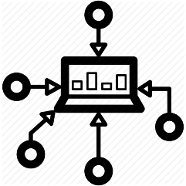
Outreach and Grievance redressal PM-KISAN
Social Media
On-boarding with CSCs
Farmers Corner
Use of social media platform such as:
Facebook
Twitter
Youtube
Common Service Centers CSCs has more than 3 lakhs VLEs, to reach out up to village level.
Enables the farmer to
Check their status
Self – register themselves
Correct the Aadhar details
24 x 7 IVRS Helpline
PM-KISAN Mobile App and Chatbot NICCI
Extension Arm of Department
Toll Free IVRS helpline launched for status verification. Farmers can dial 155261 to check their application status.
PM-KISAN Mobile App has been launched to provide direct services to the beneficiaries. More than 60 Lakh downloads done. Chatbot NICCI is also available.
Engaging organization such as
KVKs
Field offices
ICAR

Slide 14
Support required from State
Enrollment of all the eligible beneficiaries in PM-KISAN after proper verification by the States
Disposal of all pending Self-registered applications after proper verification by the States
Recovery from ineligible beneficiaries including income tax payees
Linking of Land-records with PM-KISAN
Timely resolution of grievances lodges on Help-Desk and, Physical verification of sampled records provided.

Slide 15
Why PM-KISAN is a Watershed in Agriculture Sector?
Most States/ UTs now have verified farmers’ databases and remaining are creating it by taking the details from PM-KISAN through SFTP/ API.
Many States/ UTs have digitized land records and others have started the digitization of land records.
PM-KISAN Database would provide the verified Foundational layer for Unified Farmers Service Interface/Platform (UFSP).
It is the foundation stone for Digital Agriculture.

Slide 16
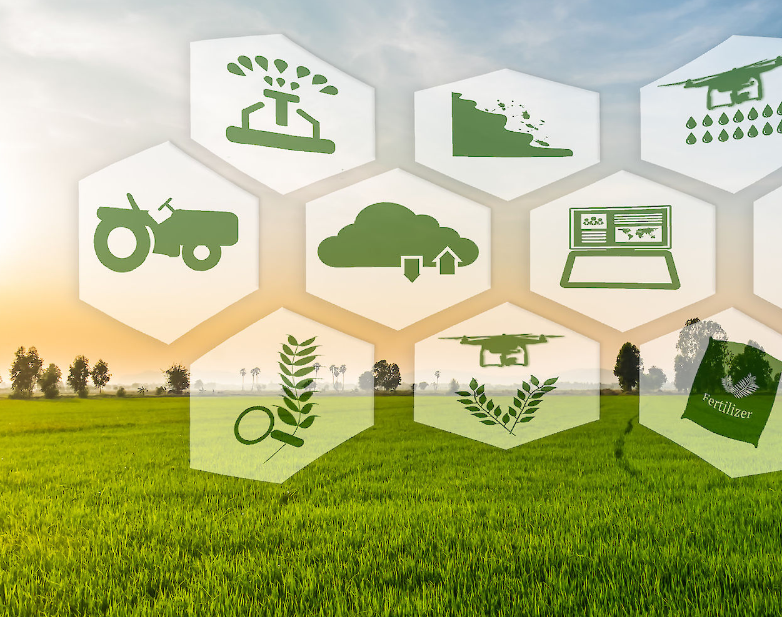
Digital Agriculture
Department of Agriculture and Farmers Welfare
Ministry of Agriculture and Farmers Welfare
Government of India

Slide 17
Budget Announcement 2022-23 on Emerging Hi-tech & Digital Agri Ecosystem
For delivery of digital and hi-tech services to farmers with involvement of public sector research and extension institutions along with private agri-tech players and stakeholders of agri-value chain, a scheme in PPP mode will be launched.
Use of ‘Kisan Drones’ will be promoted for crop assessment, digitization of land records, spraying of insecticides, and nutrients.

Slide 18
New Initiatives in Digital Agriculture
India Digital Eco-system for Agriculture (IDEA): A federated architecture model for designing interoperable databases and applications (AgriStack) and a digital data exchange ‘platform’ linking various layers of data from Public and Private Sector.
Better planning and execution of policies, programs, and schemes
Location-specific and personalized extension services
Access to high quality data for R&D and innovation in agriculture.
Formulate and leverage PPP frameworks
Capacity building and support for precision agriculture/Smart farming
Higher income realization for farmers
Building partnerships with private technology players on pro-bono basis to develop Proof of Concepts to build use case scenarios.
Proposed Digital Agriculture Mission: A new Mission with institutional framework and higher budgetary allocation. Will support State Governments on emerging digital technology (AI/ML, blockchain technology, etc), deploying drones/agriculture robots, supply chain management & e-commerce platforms.
Agri Drone Mission to build clusters across the country for custom hiring of drones for use in agricultural operations.

Slide 19
Farmers’ Database and Agri Stack
AgriStack: Using emerging technologies for building entire chain of agri-food value services (public and private) around a verified farmers database. Sharing of data through consent manager.
Farmers’ Database (FDB):
A federated farmers’ database of all farmers across the country.
Will have verified farmers with unique ID linked to Aadhar, bank details, etc.
Data from various Government schemes/departments, such as PM-KISAN,, Agri Machinery Data, KCC data, D/o Fertilizers, D/o Food & Public Distribution are being integrated and de-duplicated.
Eventually linked with digitised land records and spatial database.
FDB will be the single source of truth for achieving synergy between various schemes, benefits and services.
As of now, FDB with 4.35 cr farmers is ready

Slide 20
State/UT-wise Status of Digitized Land Records made available
States that have provided land linked data - more than 80% - 3
States Provided land linked data - less than 80% - 7
States that have not provided any data so far - 26
ANDHRA PRADESH | KARNATAKA | MADHYA PRADESH
Gujarat | Haryana | Rajasthan
UTTAR PRADESH | TRIPURA | TAMIL NADU
CHATTISGARH
ANDAMAN AND NICOBAR I | DANH&DID | ASSAM | BIHAR
HIMACHAL PRADESH | CHANDIGARH | MIZORAM, | NAGALAND,
JAMMU AND KASHMIR | KERALA | ODISHA, | PUDUCHERRY,
LAKSHADWEEP | LADAKH | PUNJAB, | SIKKIM,
ARUNACHAL PRADESH, | JHARKHAND | TELANGANA | MAHARASHTRA
MANIPUR | GOA | UTTARAKHAND, | WEST BENGAL,
MEGHALAYA | DELHI

Slide 21
Development of POC
Agristack can serve as a foundation to build innovative agri-focused solutions leveraging technologies to contribute effectively to improve farm efficiency/efficiency of the Agriculture sector in the country.
In this regard, leading Technology/Agri-tech/Start-Ups companies were identified and invited to collaborate with the Government of India and develop Proof of Concepts (PoC) based on data of select Districts/ Villages.
A public call through the Department’s website was issued inviting proposals for Memorandum of Understanding (MoU). Companies were invited to sign MoU on purely pro bono basis and develop the PoCs.
These PoCs will help in understanding the uses of Agristack and service & solutions that can be built using available data and some of them, if found beneficial to the farmers will be scaled up at National level.
In this regard, the Government has signed MoU with leading Technology/Agri-tech Players & Start-ups for working on Proof of Concepts (PoCs) in the select Districts/Villages.

Slide 22
MoUs signed with Tech Players
Mechanisms for encouraging domestic models of tech usage in agriculture.
Several Memorandum of Understanding (MoU) on pro bono basis signed.
MoU Partner | Focus of MoU | Location
Microsoft | Consolidating Agri ecosystem across the value chain (farm to fork) to empower farmers with data analytics. | 100 Villages in 5 States (Haryana, Andhra Pradesh, Gujarat, U.P, M.P.)
ITC | Build Customized ‘Site Specific Crop Advisory’ service and Digitization of Dairy Value Chain | Sehore (M.P.) Vidisha (M.P.)
Ninjacart | Digitalise the Value chain for Fruits & Vegetables through the launch of Agri Marketplace. | Indore (M.P.) Chhindwara (M.P.) Anand (Gujarat)
Star Agribazaar | Input Market linkage, Output market linkage, Crop Advisory, Input Recommendation | Guna(MP) Kota(Rajasthan) Mathura(UP)

Slide 23
MoUs with Tech Players…contd
MoU Partner | Focus of MoU | Location
Esri India | Building Agro Geo Hub, National Farmer’s database with GIS Linking to central schemes, Soil nutrient information | National level for using their solution
Patanjali | Farm Management and farmers service in 4 districts | Haridwar (U.K.) Varanasi, Hamirpur (U.P) Morena (M.P.)
Amazon | National Agri Data Stack, ccelerator program for precision agriculture startups | TBA
Jio | Integrated platform with Agri IoT & Crop Advisories | Districts of Nashik & Jalna (Maharashtra)
NCDEX | Formalizing strategy for data capturing, data capture process, Sanitization of data (pilot basis) and Utilizing data for market Linkages | Nasik[Maharashra] Davangere[Karnataka] Guntur[Andhra Pradesh]
Cisco | Crop Advisory through Cisco Smart Agriculture Platform; Agritech Startup Connect; | Kaithal (Haryana) Morena (MP)

Slide 24
National e-Governance Plan in Agriculture (NeGP-A)
NeGP-A was initially launched in 2010-11 to achieve rapid development through use of ICT for timely access to agriculture related information for the farmers.
With the new vision of Digital Agriculture, NeGP-A was amended during the year 2020-21 for sanctioning projects involving use of modern Information Technologies
Many States have initiated pilots based on the new & emerging technologies in Agriculture sector during 2020-21 to develop PoCs on domestic models of tech usage in agriculture.

Slide 25
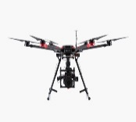
Projects under new NeGPA
Will be funding projects involving use of modern digital & emerging technologies
Technology | Probable use cases
 | Digital crop survey, Crop advisories, Mapping all data to Land, Yield assessment
 | Monitoring, Real time Information system, Planning
 | Pest surveillance, Blockchain traceability
 | Soil health, Soil moisture, Pest surveillance
 | Weeding Robots, Seeding Robots, Autonomous farm machineries
 | Pesticide spraying, Crop health monitoring, Yield assessment
Remote Sensing & GIS
Data Analytics
AI, Machine Learning & Block Chain
Internet of Things & Sensors
Robotics
Drones

Slide 26
NeGPA – Pilots taken up by States/Uts in 2020-21
S.No. | State | Technology |  | Funds Reeased (Rs Lakhs)
1 | Arunachal Pradesh | Resilient Supply Chain for identified Agricultural Crops Leveraging Digitization |  | 81.00
2 | Bihar | Digital Package of Practices for Major Crops and Automation Technique in Irrigation |  | 353.56
3 | Meghalaya | Development of web and mobile based Crop Pest Surveillance and Advisory Project |  | 62.883
4 | Uttar Pradesh | (i) UAV for Agriculture Applications, (ii) Hand Held Tool based Soil Health Monitoring (iii) Automated Fire Alert System for Crop Residue Burning in U.P. |  | 120.80
5 | Telangana | (i) Crop Monitoring (ii) Automated irrigation Systems (iii) Fertilizer Calculation (iv) Automated Farm Operation (v) Traceability from seeds to produce and (vi) Produce Grading and Quality Assaying |  | 186.00
6 | Odisha | Creation of Farmer Database |  | 178.398
7 | Punjab | (i) Development of Crop and Soil Digital Algorithms for Crop Growth Monitoring, Crop Yield and Soil Quality at Farm Level using Remote Sensing, GIS and ML Techniques (ii) Precision irrigation and sub surface drip system |  | 52.434
8 | Assam | ML based Crop Health Check up for paddy crop |  | 134.415
9 | Andhra Pradesh | Unified Digital Programme for Agriculture which includes Gap Analysis & Proposed Solution, Digital Transformation and Seamless process flow |  | 425.70
10 | Madhya Pradesh | Precision farming and Ground water availability |  | 161.106

Slide 27
NeGPA – Pilots taken up by States/UTs – Sanctioned in 2021-22
S.No. | State | Technology | Project cost | Central Share (Rs Lakhs)
1. | Sikkim | Sikkim Agriculture Resource and Management System (ARMS) | 278 Lakh | 250 Lakh
2. | Uttarakhand | 1.computerize reporting of Agricultural Statistics Land Use Statistics and Area under different crops right from village level to State level 2. A for designing, development, installation and commissioning of the smart agriculture platform using GIS, Remote Sensing, AI and IoT | 253 Lakh | 152 Lakh
3. | Nagaland | Soil & Water Resource Management, Meteorological Analysis & Forecasting System using Remote Sensing, GIS mapping, Drone and Emerging Technologies under NeGPA. | 1200 Lakh | 1097 Lakh
4 | Meghalaya | For building farmers database | 37 Lakh | 33 Lakh
5. | Tamil Nadu | creation of Unified Farmers Database and building layers or solutions over FDB | 429 lakh | 257 lakh
6. | Arunachal Pradesh | 1.Developing a resilient Agriculture /Farm Produce Supply Chain System Leveraging Digitalization in Arunachal Pradesh 2. Development of Smart Pest Surveillance System cum Geo Spatial aided Agricultural Information System | 300 lakh | 270 Lakh
7. | Mizoram | Geospatial Analytics & Decision Support for agriculture Development | 136 Lakh | 122 Lakh
8. | Haryana | Implementation of Emerging Technologies in Agriculture Sector in Haryana | 822 Lakh | 497 Lakh
9. | Andhra Pradesh | Implementation of Phase-II “UDP app to operate RBKs” | 4400 Lakh | 2667 lakh
10. | Punjab | (i) Estimation of Groundwater Unit Draft and Water (ii) Budgeting in Different Agro-climatic Regions of Puniab (iii) usiig Inilrnet of Things and Satellite Remote Sensing | 342 lakh | 205 lakh

Slide 28
Support required from State
Under NeGP-A/Digital Agriculture, States/UTs may create Farmers Database and link the digitized land records with this farmers Database
States/UTs which have submitted their proposal under NeGPA, may expedite their proposal under Digital Agriculture/NeGPA
An institutional mechanism at the State/UT level for coordination between the Departments –Revenue, Agriculture and Cooperation.
Digitization of Land record and support to the joint team of DAFW & DoLR in linking FDB with the digitised land records.

Slide 29
Thanks….

